Slide 1
Shell…………………
By : Pallavi

Slide 2
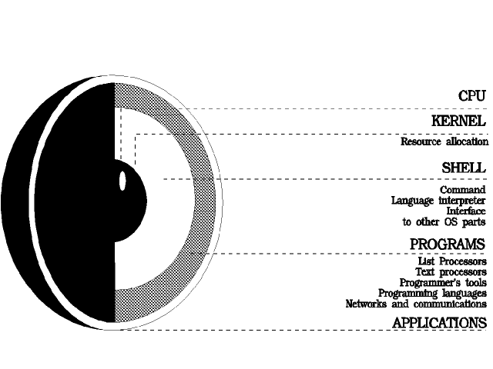
UNIX/LINUX Architecture
Notes:
9/25/20089/11/2008
2
9/11/2008
2
2

Slide 3
What is a “Shell”?
The “Shell” is simply another program on top of the kernel which provides a basic human-OS interface.
It is a command interpreter
Built on top of the kernel
Enables users to run services provided by the UNIX OS
In its simplest form, a series of commands in a file is a shell program that saves having to retype commands to perform common tasks.
How to know what shell you use
echo $SHELL
Shell
user
user
OS
user

Slide 4
UNIX Shells
sh Bourne Shell (Original Shell) (Steven Bourne of AT&T)
bash Bourne Again Shell (GNU Improved Bourne Shell)
csh C-Shell (C-like Syntax)(Bill Joy of Univ. of California)
ksh Korn-Shell (Bourne+some C-shell)(David Korn of AT&T)
tcsh Turbo C-Shell (More User Friendly C-Shell).
To check shell:
$ echo $SHELL (shell is a pre-defined variable)
To switch shell:
$ exec shellname (e.g., $ exec bash or simply type $ bash)
You can switch from one shell to another by just typing the name of the shell. exit return you back to previous shell.
Notes:
9/25/20089/11/2008
4
9/11/2008
4
4

Slide 5
Which Shell to Use?
sh ( Bourne shell) was considered better for programming
csh (C-Shell ) was considered better for interactive work.
tcsh and korn were improvements on c-shell and bourne shell respectively.
bash is largely compatible with sh and also has many of the nice features of the other shells
On many systems such as our LINUX clusters sh is symbolically linked to bash, /bin/sh -> /bin/bash
We recommend that you use sh/bash for writing new shell scripts but learn csh/tcsh to understand existing scripts.
Many, if not all, scientific applications require csh/tcsh environment (GUI, Graphics Utility Interface)
All Linux versions use the Bash shell (Bourne Again Shell) as the default shell
Bash/Bourn/ksh/sh prompt: $
All UNIX system include C shell and its predecessor Bourne shell.
Csh/tcsh prompt: %

Slide 6
What’s Shell?
It’s acts an interface between the user and OS (kernel).It’s known as “ command interpreter”.
When you type ls :
shell finds cmd (/usr/bin).
shell runs cmd.
you receive the output.

Slide 7
What’s Shell Program?
It’s collections of executables or commands placed in a file and executed.
It provides user an option to execute a command based on some condition.
It provides conditional and control statements.(if,for,while,switch-case etc )

Slide 8
A shell can be used in one of two ways:
A command interpreter, used interactively
A programming language, to write shell scripts (your own custom commands)

Slide 9
Why Shell?
For routing jobs, such as system administration, without writing programs
However, the shell script is not efficient, therefore, can be used for prototyping the ideas
For example,
% ls –al | more (better format of listing directory)
% man bash | col –b | lpr (print man page of man)

Slide 10
What is a shell………..
Shell is the interface between end user and the Linux system, similar to the commands in Windows
Bash is installed as in /bin/sh
Check the version
% /bin/sh --version

Slide 11
LINUX COMMANDS
File Management and Viewing
Filesystem Mangement
Help, Job and Process Management
Network Management
System Management
User Management
Printing and Programming
Document Preparation
Miscellaneous

Slide 12
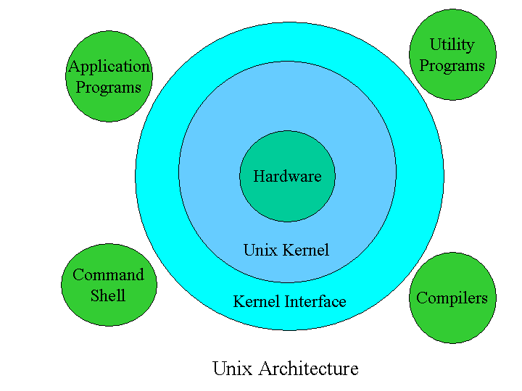
Linux/Unix Architecture

Slide 13
Shell Scripts
A shell script is just a file containing shell commands, but with a few extras:
The first line of a shell script should be a comment of the following form:
#!/bin/sh
for a Bourne shell script. Bourne shell scripts are the most common, since C Shell scripts have buggy features.
A shell script must be readable and executable.
chmod u+rx scriptname
As with any command, a shell script has to be “in your path” to be executed.
If “.” is not in your PATH, you must specify “./scriptname” instead of just “scriptname”

Slide 14
Shell Script Example
Here is a “hello world” shell script:
$ ls -l
-rwxr-xr-x 1 horner 48 Feb 19 11:50 hello*
$ cat hello
#!/bin/sh
# comment lines start with the # character
echo "Hello world"
$ hello
Hello world
$
The echo command functions like a print command in shell scripts.

